Slide 1
Modern day technology & its impact on teaching and learning
Martin, Janet & Marcus

Slide 2
What technology?
Janet’s Blog
Working out how to do something new in Excel
Watching canoeing videos to improve technique
Videoing activity to feedback to students
Powerpoint slides to share
Communication – Facebook / twitter etc
Wikis

Slide 3
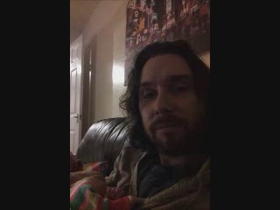
What technology?

Slide 4
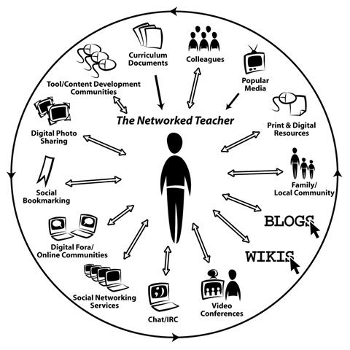

Slide 5
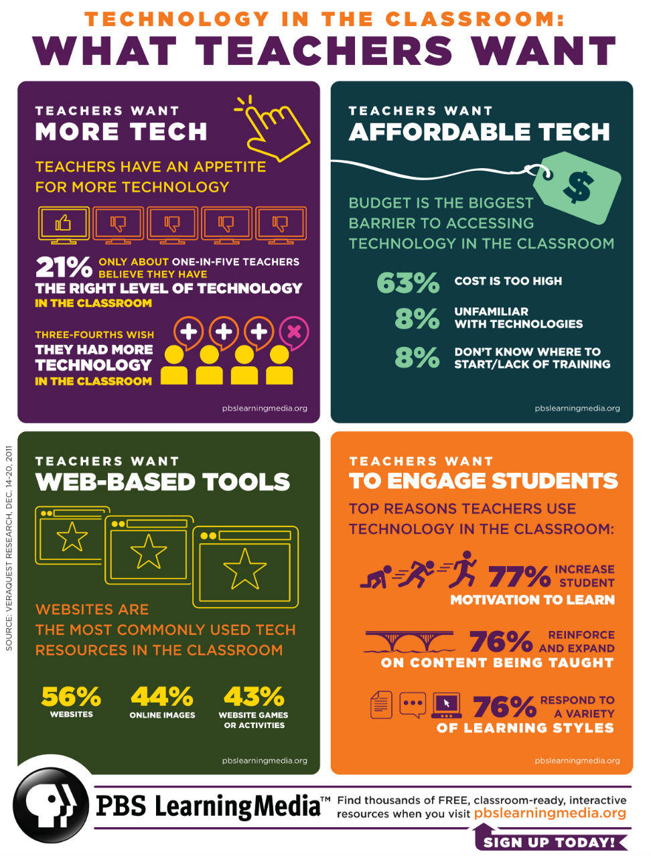
Do you agree?
Ref: [accessed 10/2/13] http://edudemic.com/2012/10/why-teachers-want-technology-and-why-they-cant-have-it/

Slide 6
THE ACTIVE PART:
Each Group to create a 2 minute presentation to share with the rest of the group
Group 1: Classify Information and Learning Technology (ILT) along the active (student centred) to passive (teacher centred) scale with examples.
Group 2: What are the Pros and Cons of using the technology for teaching and learning, using examples?
Group 3: How can ILT enhance teaching & learning for students with learning difficulties or physical disabilities?
YOU HAVE 5 MINUTES to THINK and CREATE

Slide 7
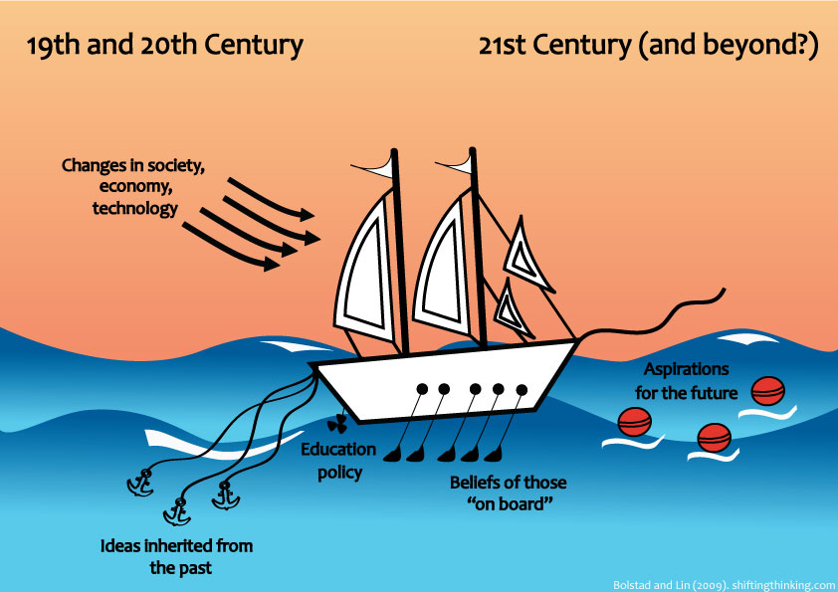
Visual Metaphor ...
Ref: http://www.shiftingthinking.org/?p=203 [accessed 10/2/13]

Slide 8
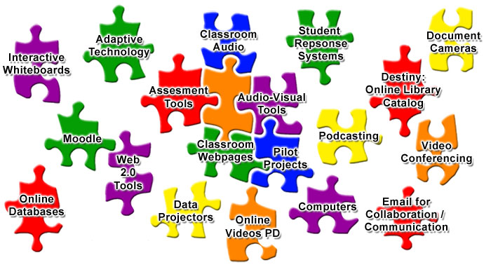
Fitting technology with active learning
Notes:
So many web pages & You Tube videos are just lectures ... Not active really!
How to do videos are useful, especially if you can practice!

Slide 9
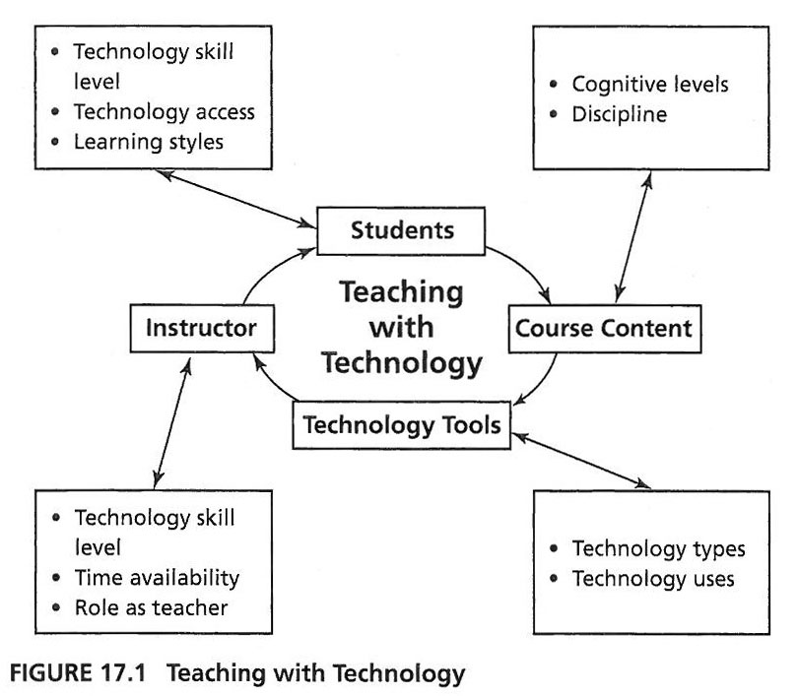
A Model for Teaching with Technology
Ref: http://www.crlt.umich.edu/teaching-technology/gettingstarted [accessed 10/2/13]

Slide 10
Information and Learning Technology (ILT) Pro’s and Con’s
Makes Learning interactive meeting all learning styles
Can make learning more accessible e.g. distance/blended learning.
Can use ILT to make/create interactive learning activities. (IT activity at study day)
Can help learners with learning difficulties/disabilities.
Can be used to gather/undertake real time assessment e.g. recording/voice recording activities.
Can enhance communication e.g. email/social networking.
OFSTED Love it!!!!!

Slide 11
Information and Learning Technology (ILT) Pro’s and Con’s
Can be time consuming for teachers to create electronic resources.
Costs and accessibility - need to have access to equipment and maybe internet
Reliant on technology – sometimes it fails!
Students may need to have a certain level of IT themselves. Could be quite scary for them!!
Teachers need to have a certain level of IT themselves. Can be scary for them!!

Slide 12
Technology needs teachers ...
“In the end, no amount of bling or flash or whiz-bang technology can replace what an expert teacher brings to the table. It’s kind of like saying that a microscope does the science. You still need a scientist to think through the possibilities, set up the experiment, direct the research, and help interpret the results.”
http://educationalexperimentalist.com/wp/?p=1447 [accessed 10/2/13]

Slide 13
Further Information/Useful resources
http://tlp.excellencegateway.org.uk/tlp/eguides/index.html - e-guides can be used to explore and create elearning resources.
Free software to create resources. Google search Hot Potatoes and xerte.
https://technology-to-enhance-ed.wikispaces.com/ - an example of a Wiki site with information about different technologies.
http://www.edutopia.org/wiki-technology - more info about wiki sites

